Slide 1
Queues

Slide 2
The Abstract Data Type Queue
A queue is a list from which items are deleted from one end (front) and into which items are inserted at the other end (rear, or back)
  It is like line of people waiting to purchase tickets:
Queue is referred to as a first-in-first-out (FIFO) data structure.
  The first item inserted into a queue is the first item to leave
Queues have many applications in computer systems:
  Any application where a group of items is waiting to use a shared resource will use a queue. e.g.
    jobs in a single processor computer
    print spooling
    information packets in computer networks.

Slide 3
A Queue
dequeue
enqueue
front
rear

Slide 4
ADT Queue Operations
enqueue(QueueItemType newItem)
  Inserts a new item at the end of the queue (at the rear of the queue)
  If array implementation is used and the queue is full, give an error message
  If linked list implementation is used and memory is full, give an error message.
QueueItemType dequeue( )
  Removes (and returns) the element at the front of the queue
  Remove the item that was added earliest
  If the queue is empty, give an error message
reset()
  Empty the queue
  If linked list implementation is used, free the memory space used by the linked list.

Slide 5
Some Queue Operations
Operation Queue after operation
an empty queue
front
↓
enqueue(5) 5
enqueue(3) 5 3
enqueue(2) 5 3 2
dequeue() 3 2 → 5 is returned
enqueue(7) 3 2 7
dequeue( ) 2 7 → 3 is returned

Slide 6
Recognizing Palindromes
A palindrome
  A string of characters that reads the same from left to right as its does from right to left
To recognize a palindrome, a queue can be used in conjunction with a stack
  A stack reverses the order of occurrences
  A queue preserves the order of occurrences
A nonrecursive recognition algorithm for palindromes
  As you traverse the character string from left to right, insert each character into both a queue and a stack
  Compare the characters at the front of the queue and the top of the stack

Slide 7
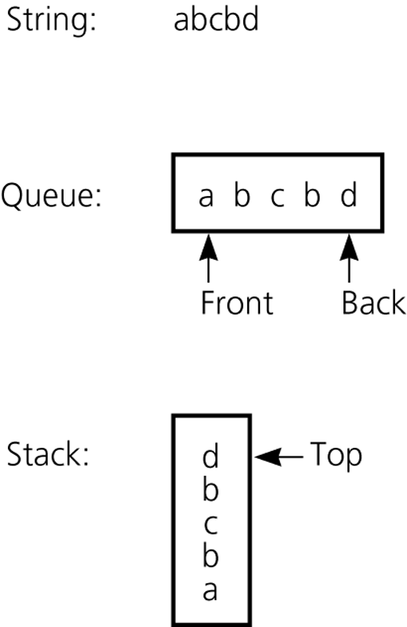
Recognizing Palindromes (cont.)
The results of inserting a string into both a queue and a stack

Slide 8
Recognizing Palindromes -- Algorithm
isPal(in str:string) : boolean // Determines whether str is a palindrome or not
len = length of str;
for (i=1 through len) {
nextChar = ith character of str;
enqueue(nextChar);
push(nextChar);
}
charactersAreEqual = true;
while (Queue is not empty and charactersAreEqual) {
if (dequeue( ) != pop( ))
chractersAreEqual = false;
}
return charactersAreEqual;

Slide 9
Implementations of the ADT Queue
Array-based implementations of queue
  A naive array-based implementation of queue
  A circular array-based implementation of queue
Pointer-based implementations of queue
  A linear linked list with two external references
    A reference to the front
    A reference to the back

Slide 10
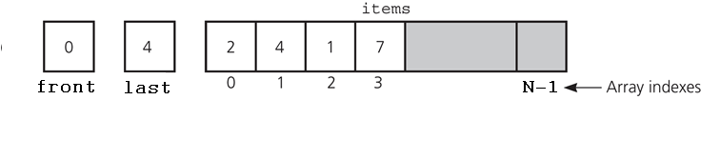
A Naive Array-based Implementation of Queue
last: shows the array element where the new item to be inserted.
enqueue( ): inserts new element to the place which is pointed by last.
dequeue( ): removes element from the 0th position, and
shifts all the remaining elements left by 1 position.

Slide 11
A Naive Array-based Implementation of Queue
#define N 500 // max number of elements
// that can be stored in the queue
int Q[N]; // Queue
int last=0; // initially queue is empty
int enqueue(int item){
if (last == N){
printf("Queue is full\n");
return -1;
}
else{
Q[last] = item;
last++;
return 0;
}
}

Slide 12
A Naive Array-based Implementation of Queue
int dequeue(){
int item, i;
if (last == 0){
printf("Queue is empty\n");
return -1; // if queue has positive values
}
else{
item = Q[0];
// shift left items in the queue by 1 position
for (i=1; i< last; i++)
Q[i-1] = Q[i];
last--;
return item;
}
}

Slide 13
A Naive Array-based Implementation of Queue
void reset(){
last = 0;
}
Analysis of the naive array-based implementation:
Enqueue: O(1)
Dequeue: O(n) because of the shift operation
Reset: O(1)
→ Circular array implementation

Slide 14
Circular Array Implementation
The front and last are the same as the basic model, except: The queue wraps around when the end of the array is reached.
last
front
1
8
3
7
0
1
2
3
4
5
6
7
8
9

Slide 15
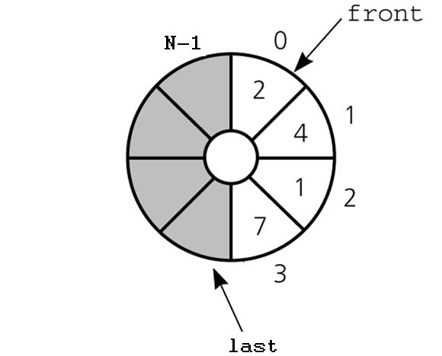
A Circular Array-Based Implementation
When either front or last
past N-1
it wraps around to 0.

Slide 16
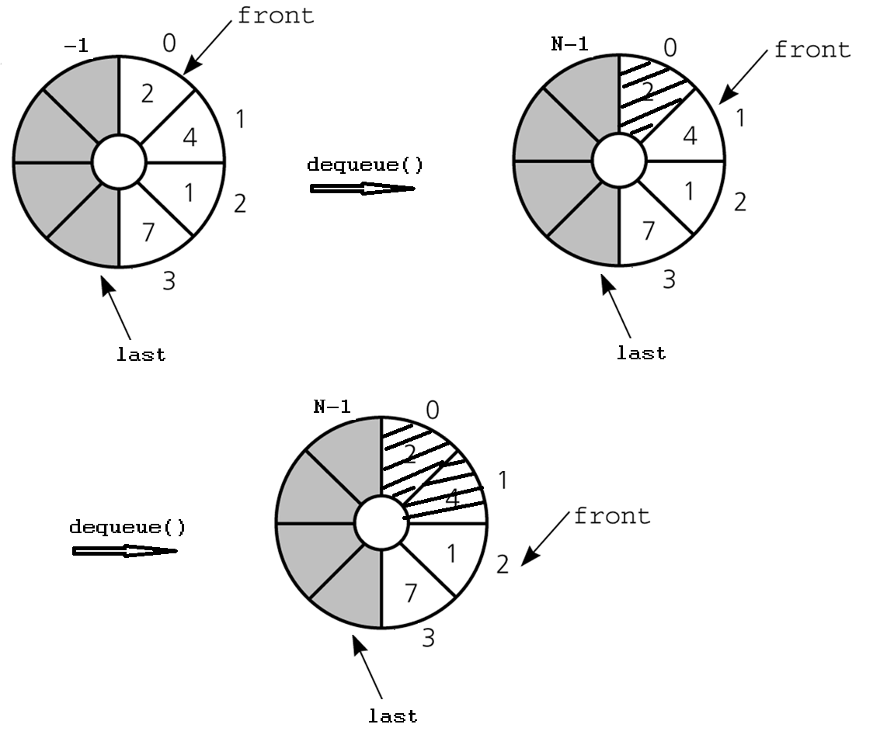
The effect of some operations of the queue

Slide 17
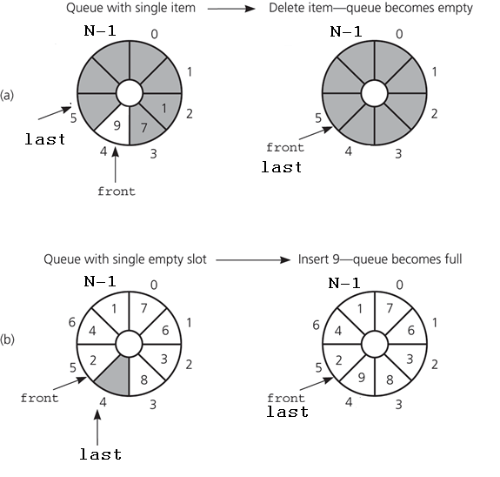
PROBLEM – Queue is Empty or Full
front and last cannot be used
to distinguish between queue-full
and queue-empty conditions.
So, we need extra mechanism to
distinguish between queue-full
and queue-empty conditions.

Slide 18
Solutions for Queue-Empty/Queue-Full Problem
Using a counter to keep the number of items in the queue.
  Initialize count to 0 during creation; Increment count by 1 during insertion; Decrement count by 1 during deletion.
  count=0 ➔ empty; count=N ➔ full
Using isFull flag to distinguish between the full and empty conditions.
  When the queue becomes full, set isFullFlag to true; When the queue is not full set isFull flag to false;
Using an extra array location (and leaving at least one empty location in the queue).
  Declare N+1 locations for the array items, but only use N of them. We do not use one of the array locations.
  Full: front equals to (last+1)%(N+1)
  Empty: front equals to last

Slide 19
Using a counter
To initialize the queue, set
  front = 0
  last = 0
  count = 0
Inserting into a queue
  Q[last] = newItem;
  last = (last+1) % N;
  count++;
Deleting from a queue
  front = (front+1) % N;
  count--;
Full: count == N
Empty: count == 0

Slide 20
Circular Array-Based Implementation
Using a counter
#define N 500
int Q[N];
int front=0, last=0, count=0;
int enqueue(int item){
if (count >= N){
printf("Queue is full\n");
return -1;
}
else{
Q[last] = item;
last = (last + 1) % N;
count++;
return 0;
}
}

Slide 21
Circular Array-Based Implementation
Using a counter
int dequeue(){
int item;
if (count == 0){
printf("Queue is empty\n");
return -1;
}
else{
item = Q[front];
front = (front + 1) % N;
count--;
return item;
}
}

Slide 22
Circular Array-Based Implementation
Using a counter
void reset(){
count = 0;
front = 0;
last = 0;
}
Analysis of the circular array-based implementation:
Enqueue: O(1)
Dequeue: O(1)
Reset: O(1)
→ Circular array implementation should be preferred

Slide 23
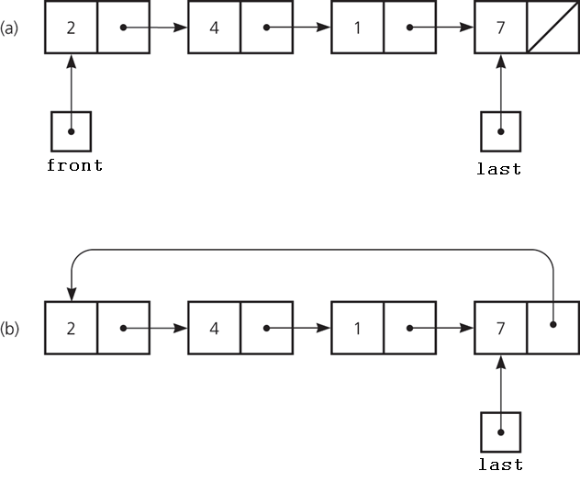
Pointer-based implementations of queue
a linear linked list with two external pointers
a circular linear linked list with one external pointer

Slide 24
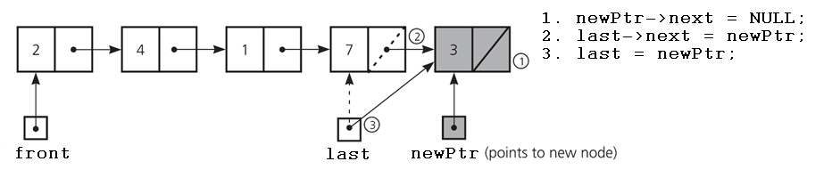
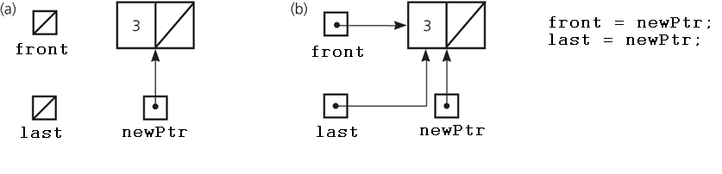
A Pointer-Based Implementation -- enqueue
Inserting an item into a nonempty queue
Inserting an item into an empty queue
a) before insertion
b) after insertion

Slide 25
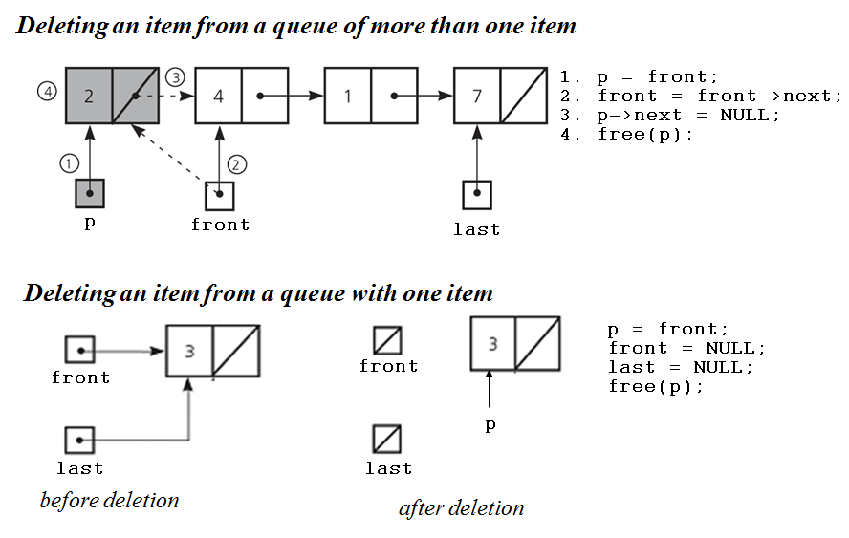
A Pointer-Based Implementation -- dequeue

Slide 26
A Pointer-Based Implementation
typedef struct q{
int item;
struct q *next;
}QUEUE;
QUEUE *front = NULL, *last = NULL;

Slide 27
A Pointer-Based Implementation (cont.)
int enqueue(int item){
QUEUE *p;
p = (QUEUE *)malloc(sizeof(QUEUE));
if (p == NULL){
printf("Memory is full\n");
return -1;
}
p->item = item;
p->next = NULL;
if (front == NULL){ // if queue is empty
front = p; // after enqueue, it has 1 element
last = p;
}
else { // otherwise, insert the new element
last->next = p; // at the end
last = p;
}
return 1;
}

Slide 28
A Pointer-Based Implementation (cont.)
int dequeue(){
QUEUE *p;
int item;
if (front == NULL){
printf("Queue is empty\n");
return -1;
}
p = front;
front = front->next;
if (front == NULL){
last = NULL;
}
item = p->item;
free(p);
return item;
}

Slide 29
A Pointer-Based Implementation (cont.)
void reset(){
QUEUE *p;
p = front;
while (p){
front = front->next;
free(p);
p = front;
}
last = NULL;
}

Slide 30
Comparing Implementations
Fixed size versus dynamic size
  A statically allocated array
    Prevents the enqueue operation from adding an item to the queue if the array is full
  A resizable array or a reference-based implementation
    Does not impose this restriction on the enqueue operation
Pointer-based implementations
  A linked list implementation
    More efficient; no size limit

Slide 31
Priority Queues
New items are inserted into the queue with respect to their priority.
Elements having the highest priority are inserted at the beginning.
// linked list implementation of priority queues
typedef struct pq{
char name[10];
int priority;
struct pq *next;
}PQUEUE;
PQUEUE *front = NULL, *last = NULL;

Slide 32
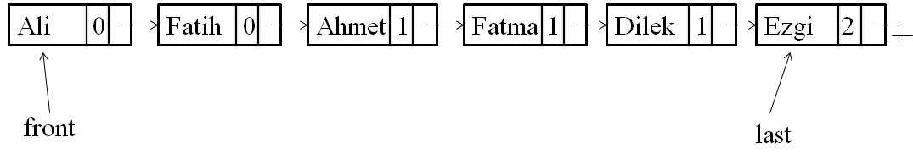
Linked List Implementation of Priority Queues
Insert the below items into the priority queue
Name priority
Ali 0 highest priority
Ahmet 1
Fatma 1
Ezgi 2 lowest priority
Fatih 0
Dilek 1

Slide 33
Linked List Implementation of Priority Queues
Enqueue(): As shown in the previous figure. Each item is inserted according to its priority value.
  If the list is empty, it is inserted as the front and last element.
  Otherwise, search for the place to insert the new item, it can be front, last, or middle.
Dequeue(): Always remove item from the front.
Reset(): Remove each item in the list one by one.

Slide 34
Priority Queue Using Heap Structure
Use min heap where the root has the minimum item. Each node must be less than or equal to its children.
Enqueue():
  Insert the new element at the end of the heap
  Call heapify() for the parent of the new element.
  Continue to call heapify() for each node until the root node.
Dequeue():
  Return the element from the root node.
  Remove the last element from the heap and copy it into the root node.
  Call heapify() for the root node.

